Slide 1
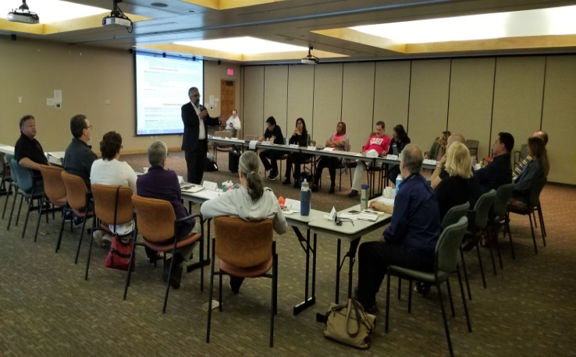
NMSBDC
Professional Development Training
Focus: Documentation of Plan
April 18, 2019

Slide 2
Agenda
Today’s focus is on the “Plan” and “Completion Date” columns for all 3 levels of the NMSBDC Professional Development Plan. This includes:
Quick review of the overall PD Program
2 primary methods for documentation
A level one example
Your assigned evaluators
Questions
Notes:
Several comments were about training, templates and tools to aid Counselors in completing the PD Plan and documentation of the plan completion.

Slide 3
PD Program
Six part Program with Employee Guide Book
On Boarding (ALL)
New Hire Orientation (ALL)
Professional Development Level 1 (Counselors)
Professional Development Level 2 (Counselors)
Professional Development Level 3 (Counselors)
Continuing Education (ALL)
Notes:
Professional Development Program parts 1,2 & 6 are for all NMSBDC employees. Parts 3, 4 and 5 are for counselors including Center Directors. Host institutions also have professional development requirements for staff and these may be entered in Neoserra in Part 6 Continuing Education.

Slide 4
PD Program 2
The levels are based upon an employee gaining the knowledge and/or skill required by each element of the core competencies.
Therefore this is not based upon on time exposed to an element or time bound except for overall completion of each level.
Levels 1 and 2 are mandatory for all
Counselors including Center Directors

Slide 5
PD Program 3
The start date is January XX, 2019 or date of hire whichever is later.
Continuing the growth of counselor knowledge and skills is the primary objective.
Notes:
Adriene – update what you as a professional want included

Slide 6
PD Program 4
Specific Requirements – Transcripts – Required to keep your professional plan updated.
Completion of levels by Counselors as well as Evaluators are guided by each of our Core Values.
If circumstances prevent timely completion coordination with your evaluator is all that is needed.

Slide 7
Method 1
WHAT YOU HAVE DONE
The specific event or experience that speaks directly to the competency on the plan is required. (See examples)
General information such as a Masters Degree does not satisfy how a competency was gained.
Specific date(s) are required.

Slide 8
Method 2
WHAT YOU PLAN TO DO
The specific event or experience that will speak directly to the competency on the plan is required. (See examples)
Specific date(s) of planned completion are required.
General information such as completing a Bachelors/Masters Degree on a specific date does
not satisfy how a competency will be gained.

Slide 9
Method 2
Example
Example of an approved plan next.
After this training, PowerPoint and examples will be added to the PD tab in the intranet. This and its location can be shared at your centers.

Slide 10
Method 2
Evaluators:
Martin- Group Charlie, Delta, and Echo
Adriene – Group Alpha and Bravo

Slide 11
Method 2
QUESTIONS?

