Slide 4
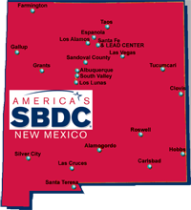

Thank You Everyone For Your Continued Support of Small Businesses in New Mexico!
The New Mexico Small Business Development Center Network
Centers Statewide
No-Cost confidential business consulting
Low-cost business training workshops
Certified business professionals
The NMSBDC is funded in part through a cooperative agreement with the U.S. Small Business Administration. All options, conclusions or recommendations expressed are those of the NMSBDC and do not necessarily reflect the views of the SBA. Reasonable accommodations for persons with disabilities will be made if requested at least two weeks in advance.

Slide 5

Thank You Everyone For Your Continued Support of Small Businesses in New Mexico!
The New Mexico SBDC is funded by:
the State of New Mexico;
the United States Small Business Administration (SBA);
the US Department of Defense for the Procurement Technical Assistance Program; and
hosted at colleges and universities throughout our state.
Together we are building New Mexico’s economy, one business at a time!
The NMSBDC is funded in part through a cooperative agreement with the U.S. Small Business Administration. All options, conclusions or recommendations expressed are those of the NMSBDC and do not necessarily reflect the views of the SBA. Reasonable accommodations for persons with disabilities will be made if requested at least two weeks in advance.

