Slide 1
Training & Guidance for Program Staff Concerning COVID-19
March 20, 2020
Notes:
Glenn -- Groundrules for today – Write down your questions as we proceed and ask them during the QUESTION/ANSWER section using the chat function. DO NOT USE THE CHAT FEATURE UNTIL THE QUESTION/ANSWER SECTION: Focus on presentation – no calls, emails, etc.;

Slide 2
Overview
Provide a foundation for assisting clients with COVID-19 challenges:
Presentation
Links to resources
Expectation of self learning by all staff
Followed up by detailed presentations
and or webinars.
Notes:
Glenn

Slide 3
Financial Assistance
Steps
Diagnostic Counseling with detailed notes in order to direct to the appropriate program.
Identify the need to determine which lane they need to go into.
Six Lanes: Expense deferment/cost cutting, Negotiate terms of existing loans, Local Lender(COVID-19 BLGP), Micro lenders, LEDA and SBA EIDL
Help client develop a plan and provide technical assistance to accomplish.
Notes:
Adriene
Number of Employees, time in business, are you behind in any bills, how much do you think you need. Take detailed notes because you may need to referred back to them as new programs become available or current programs change.
Expense cutting leaves money in your pocket now.

Slide 4
Federal – SBA
Declared Disaster
Assistance
Coronavirus (COVID-19): Small Business Guidance & Loan Resources
SBA presentation slides 3-11
Notes:
Adriene starts and then Russell takes over with SBA presentation

Slide 5
Starting and Navigating the SBA Disaster Loan Application
Notes:
Russell

Slide 6
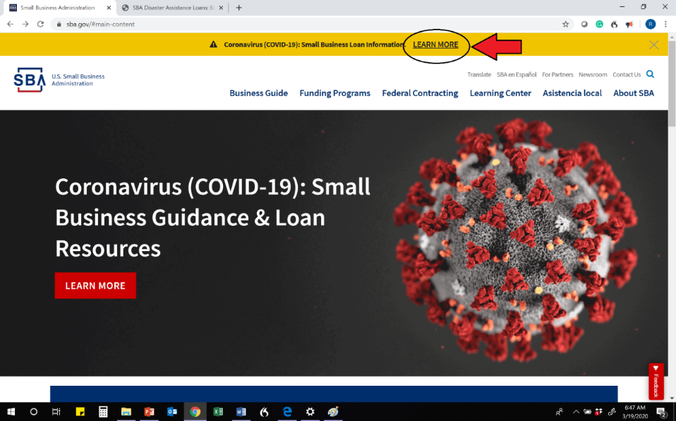
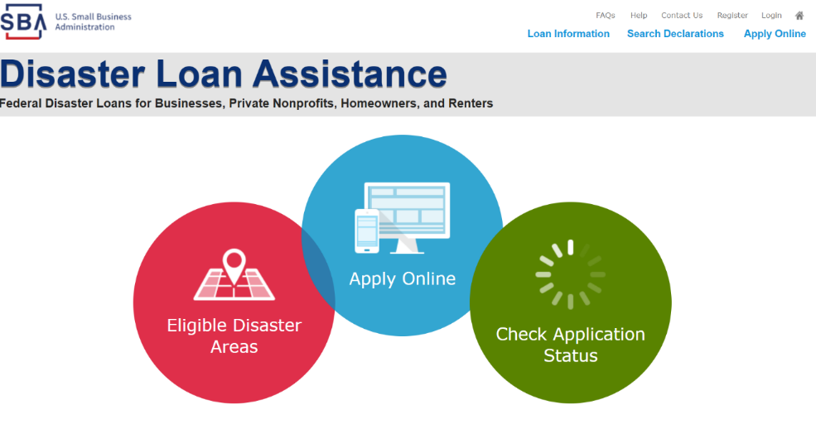
Locating the Loan Application Page on SBA Website
The application can be completed online or by submitting a paper application
Notes:
Russell

Slide 7
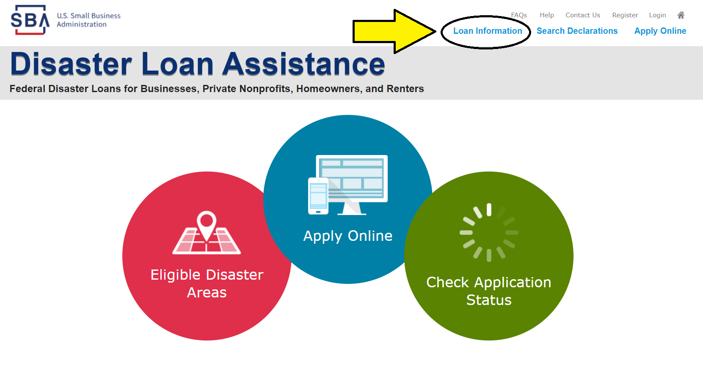
Finding the Paper Application
Notes:
Russell

Slide 8
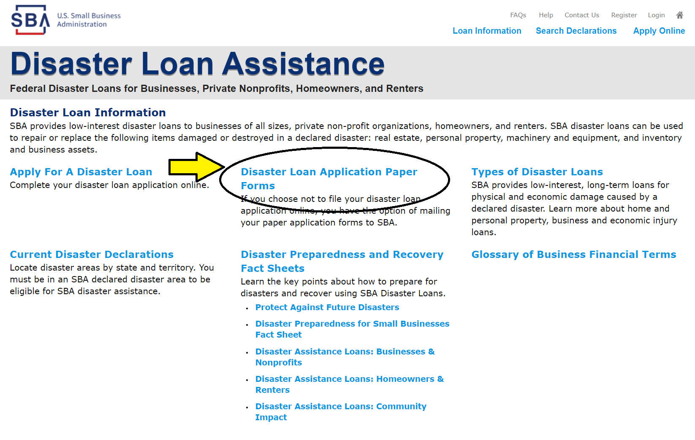
Finding the Paper Application
Notes:
Russell

Slide 9
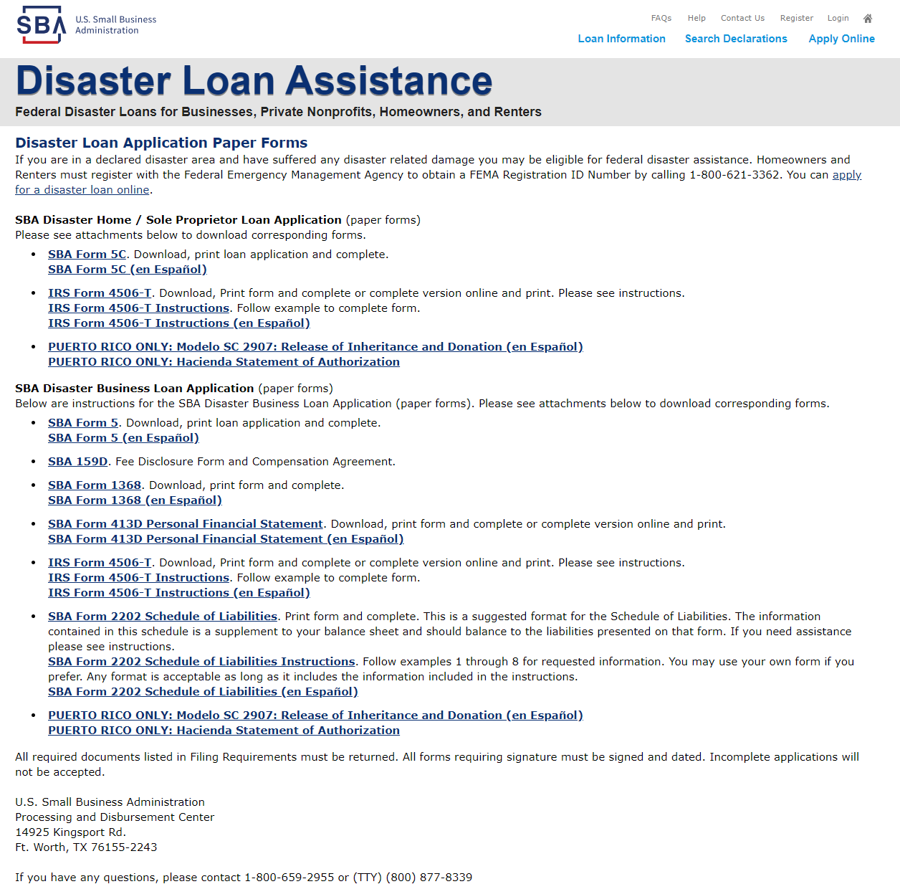
Finding the Paper Application
Because the online application forces you to complete forms in order, it may help some clients to review these paper forms and gather their data first.

Slide 10
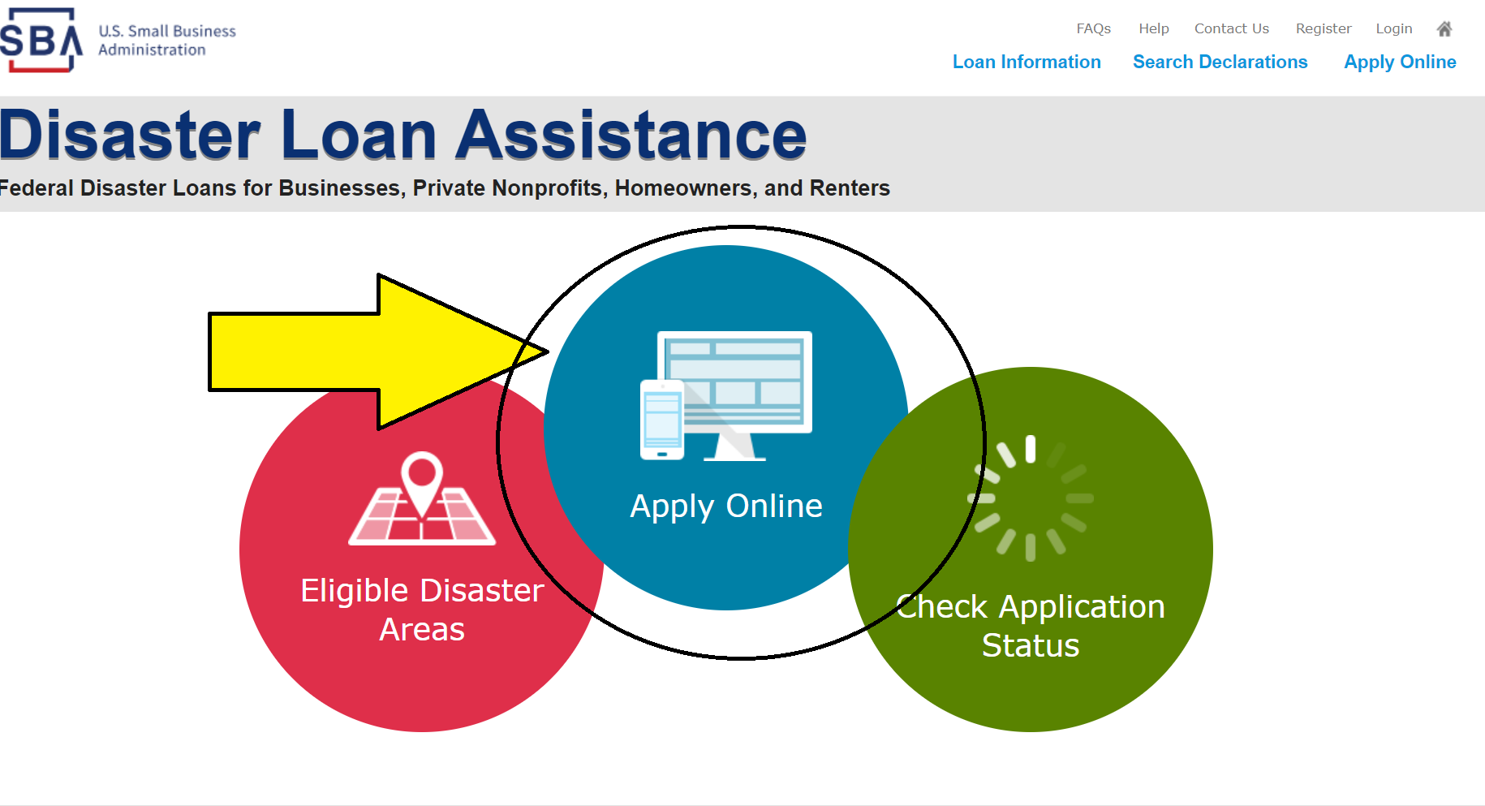
Finding the Online Application
Notes:
Russell

Slide 11
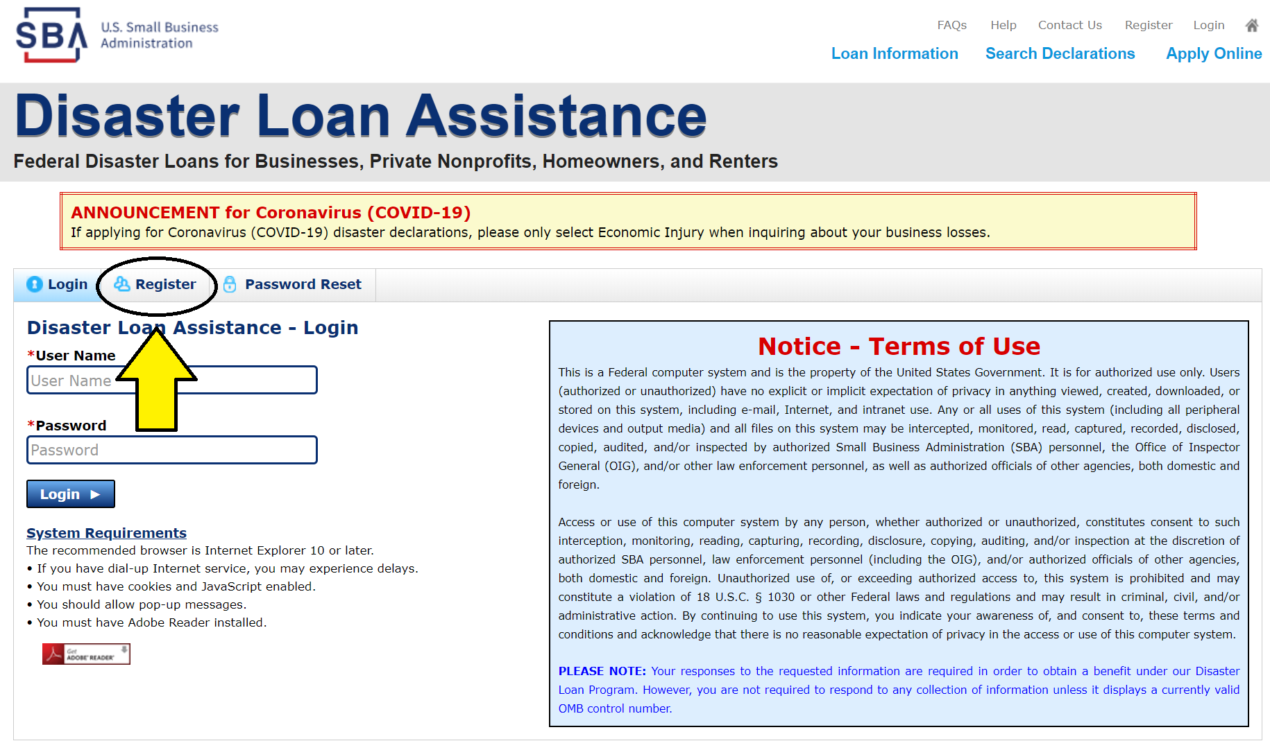
Online Application First step: Registration
Notice the announcement on top of this page. Clients will need to remember to only select Economic Injury on the application page about business losses.
Notes:
Russell

Slide 12
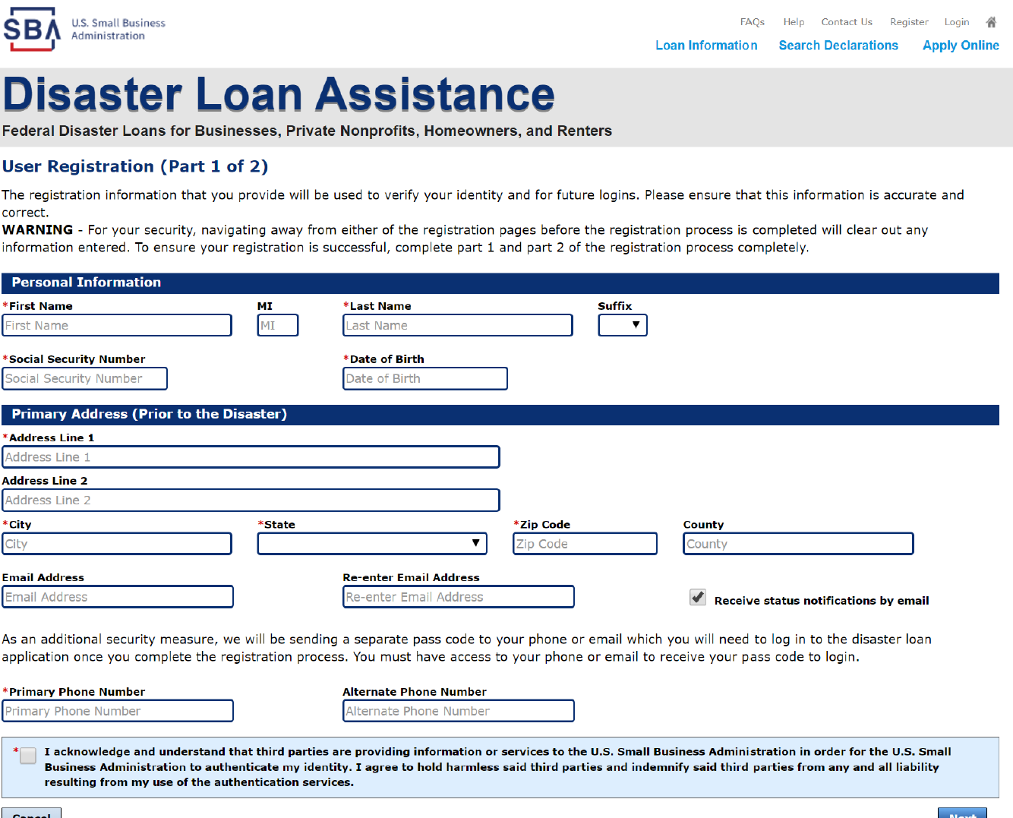
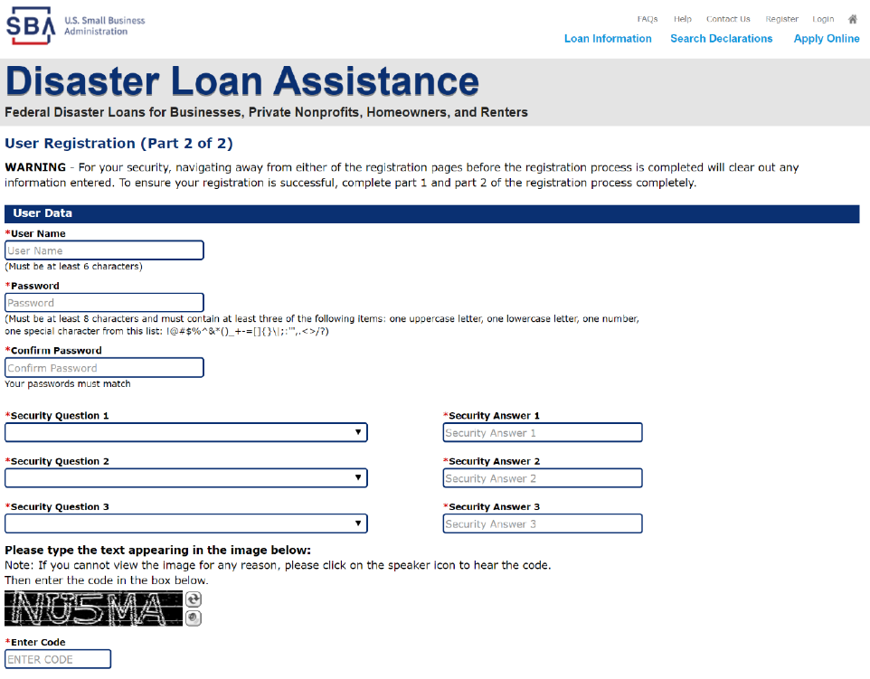
Online Application Registration pages 1-2 and
Notes:
Russell

Slide 13
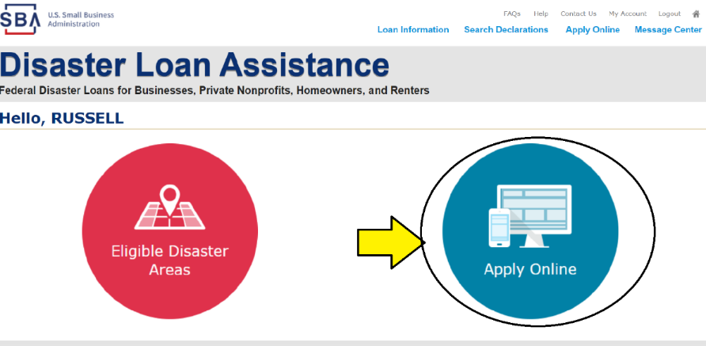
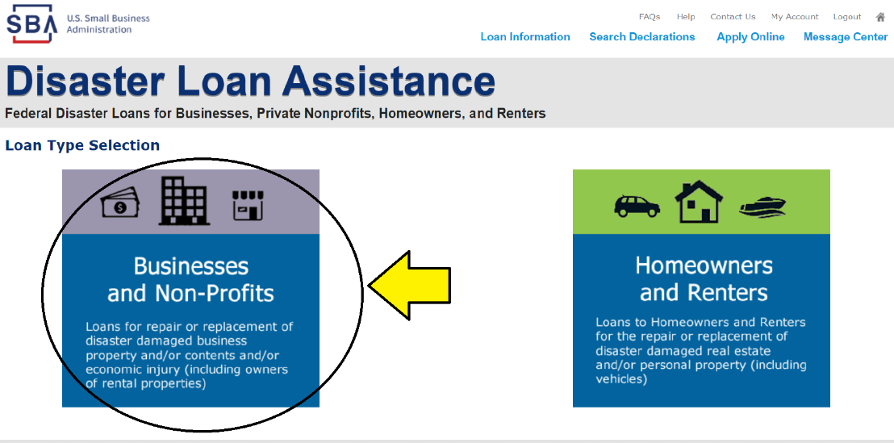
Starting the Application
Notes:
Russell

Slide 14
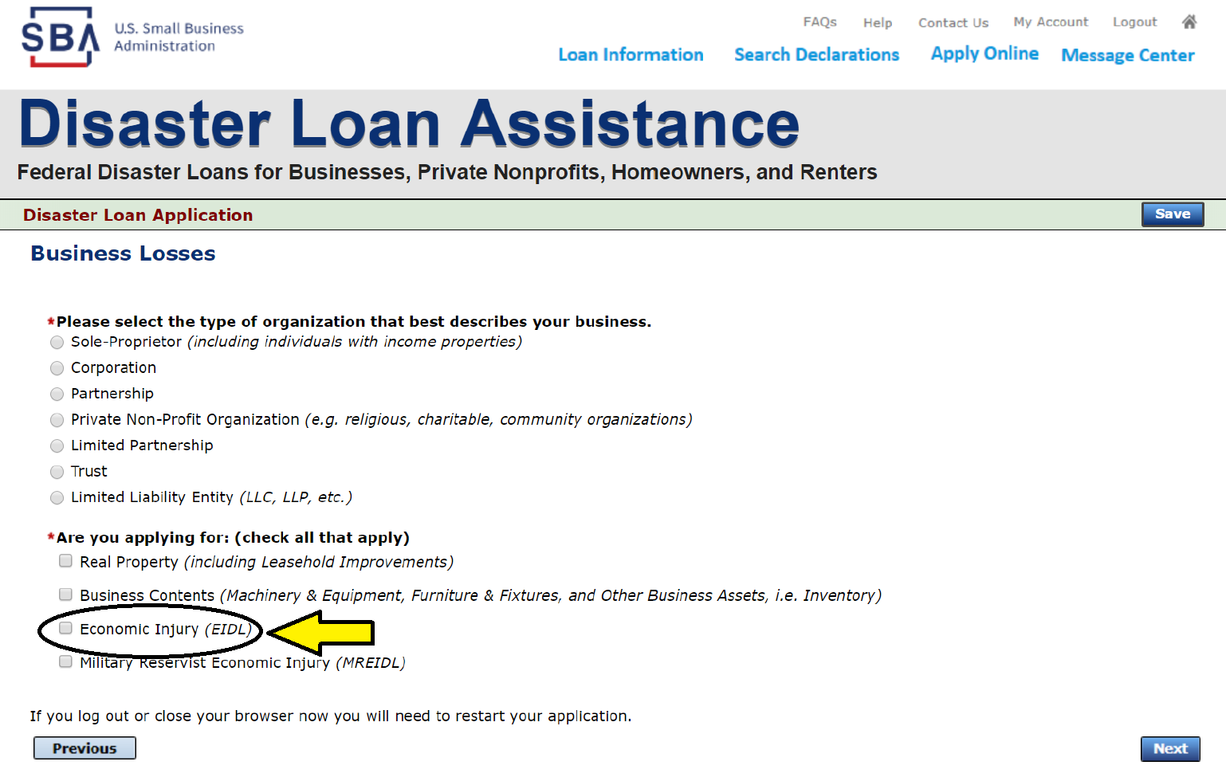
Starting the Application 1st Page
Notes:
Russell

Slide 15
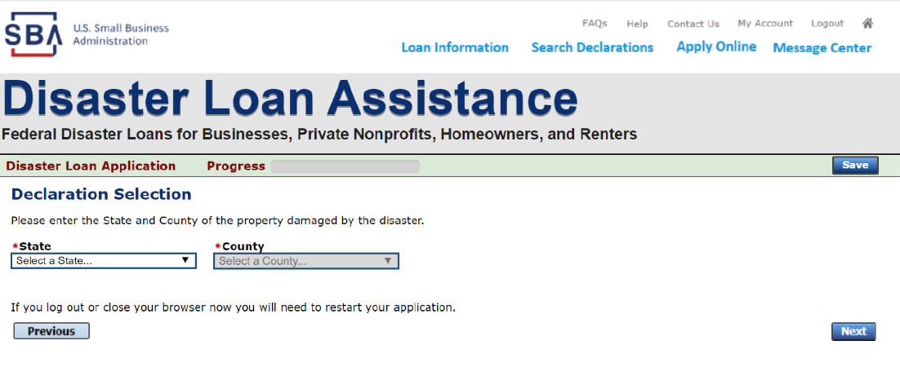
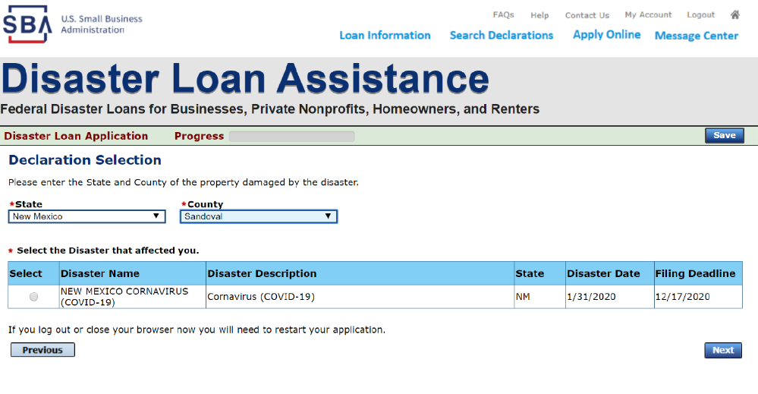
Starting the Application 2nd Page
They will select New Mexico in the first box and the second box will populate with the list of the 33 counties to select from.
The New Mexico COVID-19 Disaster will appear on the screen for them to select.
Notes:
Russell

Slide 16
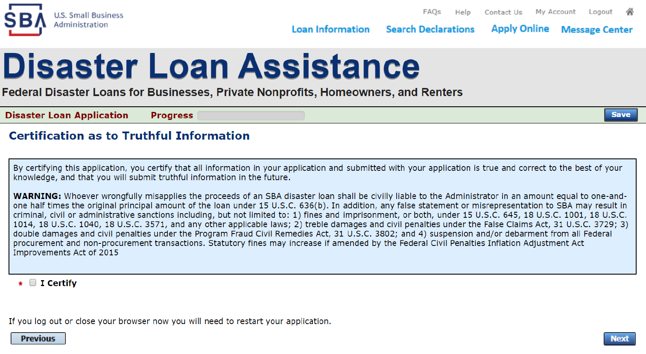
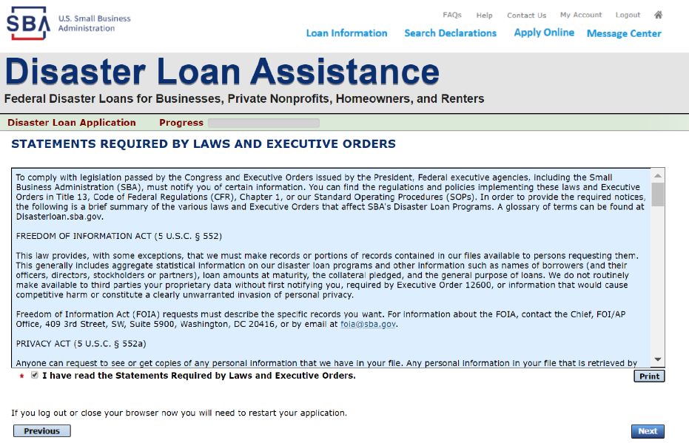
Starting the Application 3rd and 4th Pages
Notes:
Russell

Slide 17
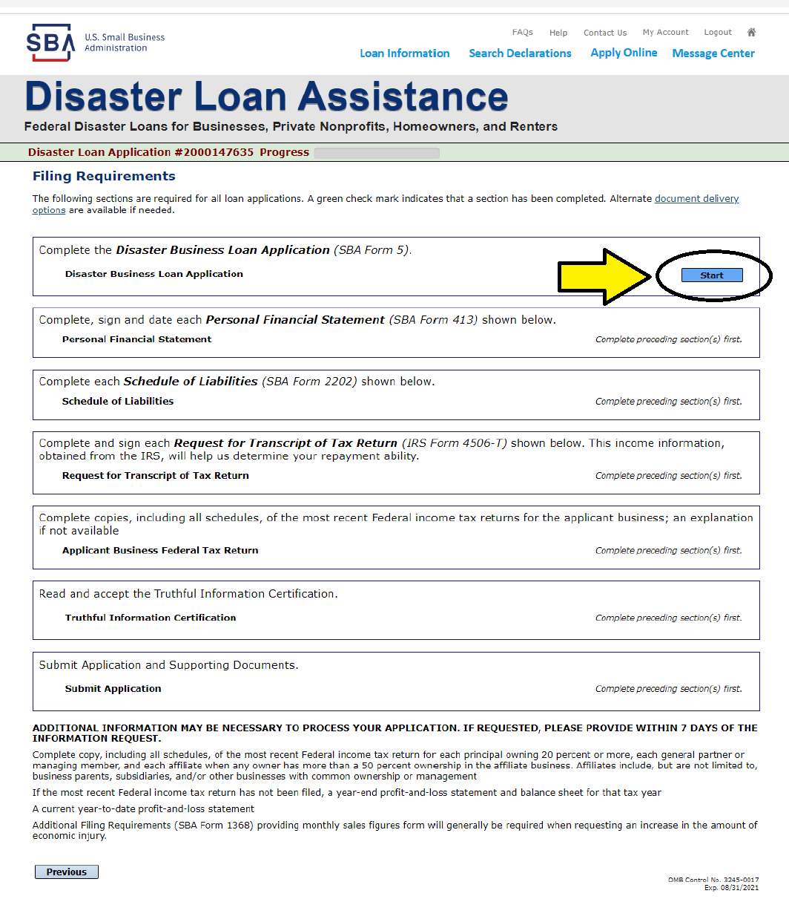
Main Application Page
They will see their application number at the top of the screen and a progress bar that will fill up as they complete each section of the application.
Notes:
Russell

Slide 18
State - Help
for Businesses
COVID-19 Business Loan Guarantee Program
NMEDD can guarantee a portion of a loan or line of credit up to 80% of principal or $50,000. Loan proceeds are flexible and can be used for (and not limited to) the following: working capital, inventory and payroll.
Process:
Borrower approaches lender
Lender applies to the program
Lender and NMEDD sign agreement
Lender makes the loan
NMEDD guarantees the loan in case of default
Notes:
Adriene

Slide 19
State - Help
for Businesses - 2
LEDA Zero-Percent Interest Loans
Limited to expenditures for land, building and infrastructure
Can be used for lease abatement or mortgage assistance
Company must be a qualified entity (manufacturer, non-retail service business with more than 50% of revenue generated out of state, or a retail business in a community or less than 15,000 in population)
All loans will be required to provide security equal to the amount of the loan
For assistance with LEDA loans, find & contact your Regional Representative, or contact Mark Roper, Mark.Roper@state.nm.us or 575.562.0327
Notes:
Adriene

Slide 20
State - Help
for Businesses - 3
New Mexico Finance Authority: Business Loan Partnership Program
NMFA and “Partner Banks,” together, share risk while lowering the overall cost of borrowing for the business by NMFA offering low-cost rates on its portion of the loan to a New Mexico business. Contact, John Brooks, 1-877-ASK-NMFA, or jBrooks@nmfa.net
Notes:
Adriene

Slide 21
State - Help
for Businesses - 4
NM Department of Workforce Solutions
Information for Workers & Businesses Affected by COVID-19
Certain workers may be eligible for Unemployment Insurance (UI) benefits. You may be eligible if the situations described below apply to you:
Employers may lay off some or all of their workforce as a result of the impact of COVID-19; for example, a restaurant that sees a significant reduction in business due to lack of customers dining out during this time, or an event facility that cancels all events until a later date, or bus drivers who are out of work due to temporary school closures.
Workers who are self-quarantined or directed to be quarantined, or who have immediate family who is quarantined.
Workers who have their hours reduced as a result of
COVID-19.
Notes:
Adriene – tell network to investment time in studying the information on the NMDWS website

Slide 22
State – Grant
Opportunities
It is likely that some Grant Opportunities will become available and we will update our Website if/when these types of opportunities materialize.
Facebook Small Business Grants Program
Amazon
Walmart
Notes:
Adriene – talk to a few examples. Also, this is a reminder of why you should take good notes when meeting with clients.

Slide 23
Make A Plan
Here is some advice on how to prioritize the payment of your small business bills, starting with the most essential:
Taxes: The money that you collect for federal payroll taxes (including Social Security and Medicare) and state sales and income taxes does not belong to you; it belongs to the government. And if you don’t pay these taxes at the appropriate time, you will face stiff fines and penalties. The Internal Revenue Service (IRS) has broad powers to garnish wages, take control of business equipment and property, and even seize funds from an Individual Retirement Account (IRA). It can also charge you with a crime for failing to deposit your payroll taxes appropriately.
Payroll: Not only do some state laws impose penalties for not paying your employees’ wages on time, if you don’t take care of the people who work for you, you risk losing them and your business. You may like to think of your employees as a family, but missing payroll may force them to look for other opportunities.
Notes:
Russell

Slide 24
Make a Plan - 2
Aged Payables: An aged payable is a bill that is overdue by 60 days or more. These bills put your business credit score at risk, making it more difficult to secure future financing. Also, these outstanding balances accrue a lot of interest, making them more expensive with each passing day. Creditors whose bills are aged are the first people you should call to try and arrange a payment plan. Even offering partial payment is better than ignoring them.
Utilities and Rent: You can’t run a business without electricity and a phone line. Lights, Internet service, heating and air conditioning, etc. are essentials. If you are behind on your utility bills, your services can be cut off and leave you in the dark — literally. Try to negotiate a payment plan with your service providers, and don’t assume they won’t pull the plug if bills are left unpaid. Also, your landlord can evict you for nonpayment of rent. If you are seriously overdue, you’d better try to negotiate a forbearance, a partial payment or find emergency rent assistance before the locks get changed.
Notes:
Russell

Slide 25
Make a Plan - 3
Key Vendors and Suppliers: You depend on your key vendors and suppliers for your business to operate. Of course, they also depend on you for their companies to thrive, so it is in everyone’s interest to keep these relationships healthy. Talk to your business partners and let them know your situation. Try to negotiate a payment plan that allows you to pay partial amounts while deferring full payment. This buys you some time to address your cash flow problems, while ensuring that your business partners stay solvent. If you have been a good customer in the past, it’s more likely that your key associates will agree to some sort of payment modification.
Insurance Premiums: You don’t want to operate without liability insurance for any extended length of time, but if you need to eliminate a specific payment, you might have to take the risk. Before letting insurance lapse, however, try to reduce premiums by downsizing coverage or increasing deductibles.
Notes:
Russell

Slide 26
Make a Plan - 4
Secured Debts and Debts You Have Personally Guaranteed: If your business is a sole proprietorship or partnership, you are personally liable for all of your business debts. If your business is a corporation or LLC (Limited Liability Company), you are only liable for debts that you personally guaranteed. In either case, you need to pay these obligations before any unsecured debts or loans get reimbursed. If the debt is secured by a specific piece of collateral that is crucial to your business, repossession of the item for nonpayment could shut you down. If the debt has been personally guaranteed by you, you are putting your own personal assets in jeopardy.
Notes:
Russell

Slide 27
Make a Plan - 5
Large Bills vs. Small Bills: Keeping your business credit score high is an important consideration when you are forced to prioritize your payments. Missing large bills will have a greater negative impact on your credit score because they carry more weight. Also, large companies are more likely to report a delinquency to the credit bureaus. However, sometimes you might need to pay smaller bills to smaller companies that depend on your business for their survival. Again, the best option, if you have enough funds, is to try and pay at least something to everyone you owe, while being honest and upfront with them about your cash squeeze.
Credit Cards: Credit card debt is normally unsecured debt, so a creditor cannot do much without suing you first and getting a court judgment. So while these bills still have to be paid, they can take a lower place on your priority list. But remember: penalties and interest charges on credit card balances can add up quickly. Try to make at least the minimum payment each month to avoid mounting debt.
Other Business Debts: Your lowest priority is other, less essential business debts such as professional dues, magazine subscriptions, advertising, entertainment, non-crucial repairs and maintenance.
Notes:
Russell

Slide 28
Non-Financial
Assistance
Numerous Federal, State & Local organization have released guidance to assist coping with COVID-19.
We will now visit a few websites to gain insight into suggestions, tips, guidance, etc.
It is urgent for you to take time to visit and review the information on the websites that will be presented in the next few slides.
Notes:
Glenn - As was mentioned earlier you need to take responsibility for YOUR self learning!

Slide 29
Federal
Small Business Administration (SBA) Guidance
Centers for Disease Control (CDC) Guidance
Department of Labor Guidance
U.S. Chamber of Commerce Guidance
ASBDC Guidance
Notes:
Glenn

Slide 30
SBA
Guidance for Businesses and Employers to Plan and Respond to Coronavirus Disease:
https://www.sba.gov/page/coronavirus-covid-19-small-business-guidance-loan-resources#section-header-2
Notes:
Glenn

Slide 31
CDC
Interim Guidance including recommended strategies for Businesses and Employers available at CDC’s Guidance for Businesses and Employers
Notes:
Glenn

Slide 32
Labor
A 35 page Guide on Preparing Workplaces for COVID-19 is provided by the Department of Labor at:
https://www.osha.gov/Publications/OSHA3990.pdf
Notes:
Glenn

Slide 33
U.S. Chamber of
Commerce
Resources and Guidance for Businesses to Combat Coronavirus:
https://www.uschamber.com/coronavirus
https://www.uschamber.com/coronavirus-response-toolkit
Notes:
Glenn

Slide 34
ASBDC
Shared documents section
https://americassbdc.org/coronavirus-information/
Notes:
Glenn

Slide 35
State
Department of Health Guidance
Association of Commerce and Industry (ACI) Guidance
NMSBDC Website
Notes:
Glenn

Slide 36
Health
New Mexico Department of Health Guidance at:
https://cv.nmhealth.org/
Notes:
Glenn

Slide 37
ACI
New Mexico Association of Commerce and Industry Coronavirus Guidance at:
http://nmaci.org/combating-the-coronavirus.aspx
Notes:
Glenn

Slide 38
NMSBDC Website
Our Website:
http://www.nmsbdc.org
Notes:
Adriene

Slide 39
Disaster Guide
SBA Resource Partners Disaster Preparedness, Response and Recovery Guide
http://www.nmsbdc.org/
SBA Resource Partner Disaster Response Team prepared the Guide for businesses
SBA, NMSBDC, SCORE, WESST, VBOC, NMEM, NM Counties
A comprehensive planning document to prepare for any type of disaster
Fillable PDF forms
Takes into account most areas needed for response and recovery
Notes:
Mike

Slide 40
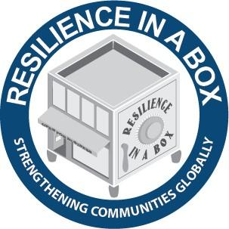
U.S. Chamber
of Commerce
https://www.uschamberfoundation.org/resilience-box
Based on best practices on business resilience
These resources will guide companies toward addressing preparedness issues while building in flexibility to handle potential business interruptions
Includes Business Preparedness Checklist
Top 20 Tips for Preparedness
Notes:
Mike

Slide 41
Top 20 Tips
Build a Team to create plan
Get top level buy in
Keep Disaster Plan simple
Gather critical documents and information to make decisions
Identify and then prioritize critical operations and processes
Identify your hazards, the potential disruptions to your operations
Build your plan and create a “grab and go” case
Stockpile essential emergency supplies
Maintain Contact lists – Update emergency lists for your employees, vendors, suppliers, and key contacts
Recruit employee volunteers to become trained
emergency
responders
Notes:
Mike

Slide 42
Top 20 Tips - 2
Take the message home: Develop a prepared workforce – business readiness doesn’t end at work
Back up and protect your vital records and data
Take action to mitigate potential impacts to your equipment, buildings, and facilities
Cultivate Partnerships
Protect your inventory and storage before it is lost to the disaster and you have
nothing to sell
Establish and maintain communication in a crisis to ensure that your employees, suppliers, customers, and the
public are getting the
facts directly from you
Exercise and test your plan
Keep your plan updated
Implement the plan
Connect with the local economy
Notes:
Mike

Slide 43
H.R. 6201
R
On March 18, President Trump signed H.R.6201, Families First Coronavirus Response Act into law. A good summation is at:
https://www.shrm.org/resourcesandtools/legal-and-compliance/employment-law/pages/senate-to-vote-soon-on-coronavirus-paid-leave-mandate.aspx
Notes:
Glenn – rapidly changing and posting on the NMSBDC website with updates will occur

Slide 44
R
QUESTIONS/COMMENTS
Notes:
Glenn - The chat function is now open and enter your question in the chat function. Mike takes notes and we will response later.

Slide 45
R
CLOSING COMMENTS
Notes:
Russell

